Slide 1
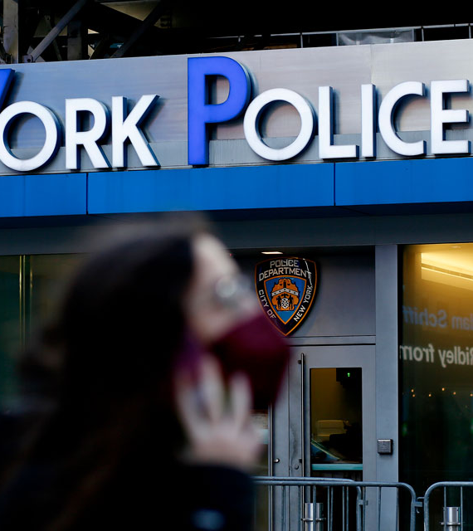
Finding the safest borough to move into: data driven approach

Slide 2

Introduction:
In the dynamic world of New York City real estate, ensuring safety is a high priority. As a data analyst for our real estate company, I've been tasked with exploring NYPD arrest data to help people find the safest neighborhoods to live in NYC.

Slide 3
Objective:
The objective of this project is to analyze New York Police Departments or NYPD arrest data to identify the safest borough in NYC. By examining various crime and arrest statistics, I aim to provide insights that will assist our clients in making informed decisions about where to live.

Slide 4
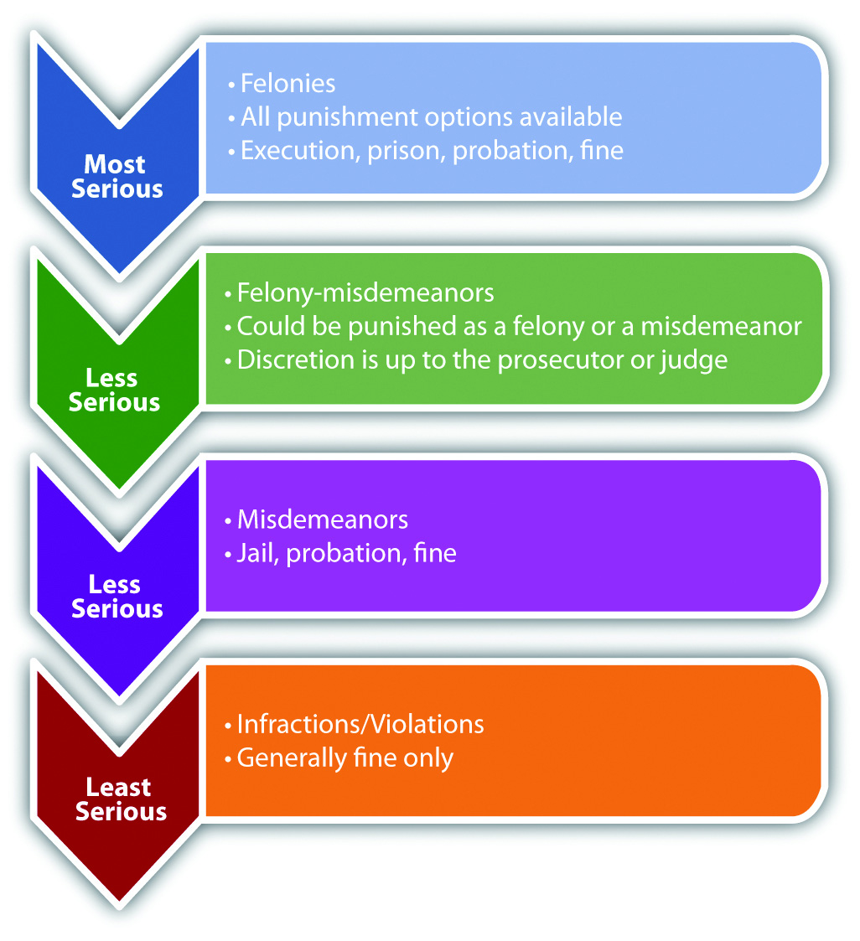
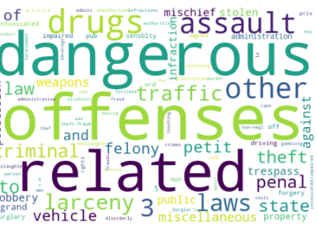
Source

Slide 5

Data Sources and methodology

Slide 6
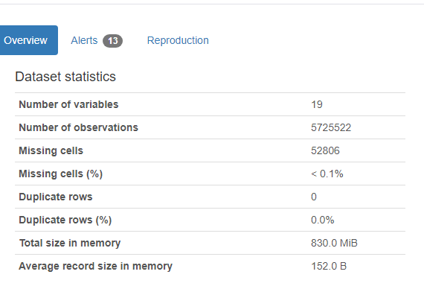
Primary source:
The primary data for this project was pulled from Data.Gov. The NYPD Arrest (historical) data covers every arrest records from 2006 to 2023, totaling 5.7 million records of arrest. For this analysis, I focused on the years 2014 to 2023, resulting in 2.5 million arrests. I also gathered NYPD precinct locations to understand their impact on the arrests.
Disclaimer:
There are null values in both the Law Category and offenses columns, and I have categorized several incidents as 'uncategorized.' This makes it challenging to fully understand the nature of these specific arrest.

Slide 7
Secondary source:
In addition to crime data, I was curious to understand the recent asking rent rates across NYC boroughs, which is particularly relevant for a real estate company. I collected median asking rent rates from StreetEasy to provide a comprehensive view of rental costs.
Preprocessing:
One limitation of the real estate data is that it included many individual neighborhoods, with columns representing individual months from 2010 to 2023. To align with the NYPD arrest data, I had to create a new spreadsheet that consolidates the data by boroughs, showing yearly average prices for the years 2014 to 2023.

Slide 8
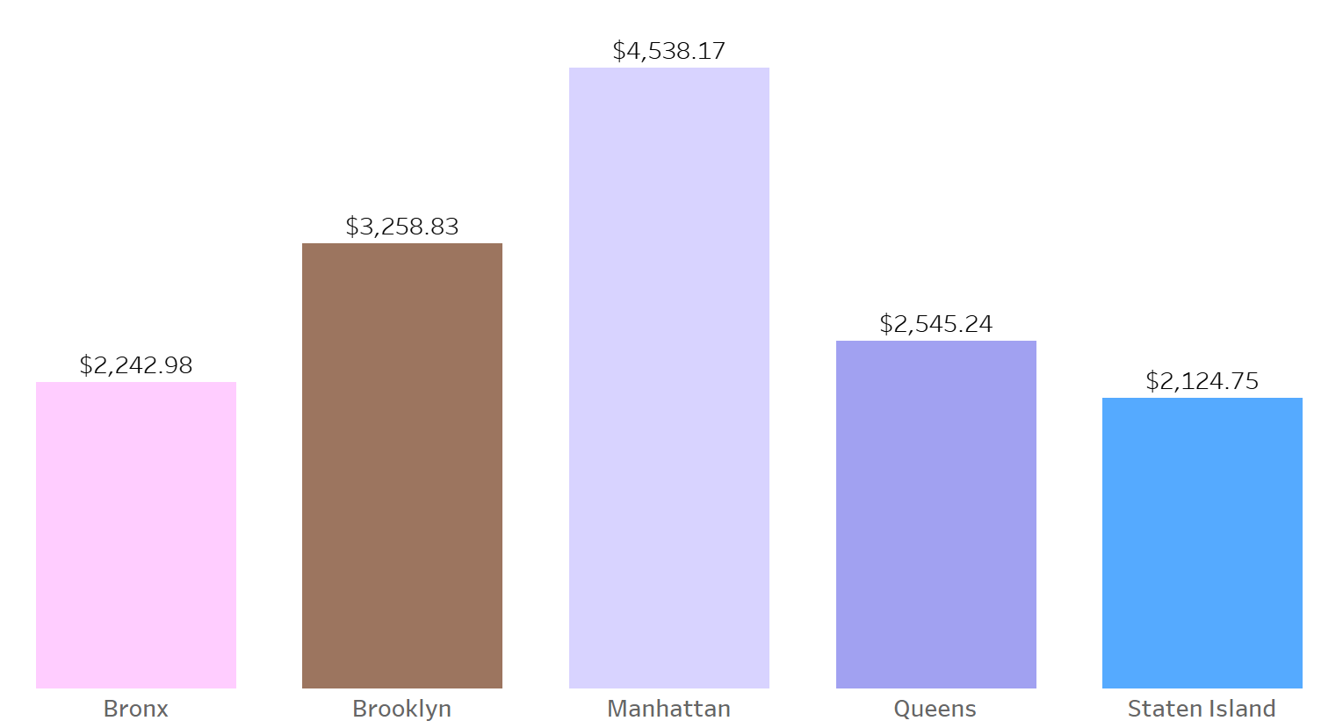

Slide 9
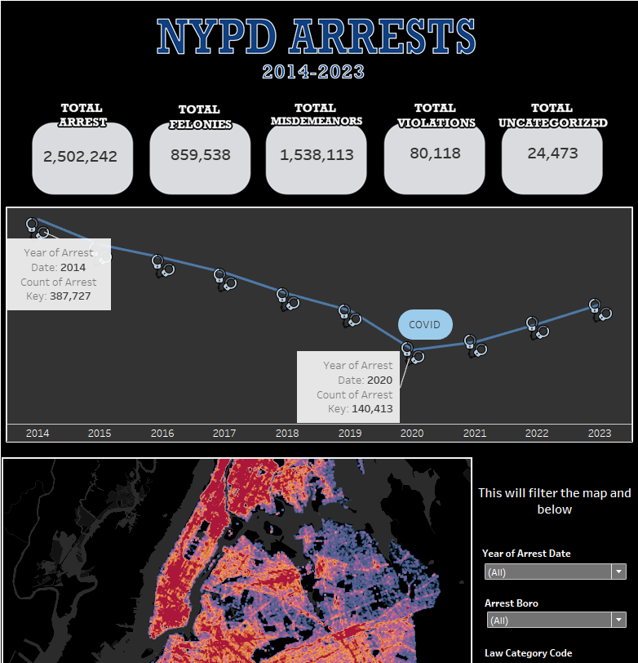
Tableau Dashboard
Interactive dashboard that analyzes crime profiling, spatial and time (year).
Full size is available in Tableau Public.

Slide 10

Insights and summary
The year 2014 recorded the highest arrests at 387,000, followed by a decline during the years 2019-2020, coinciding with the COVID-19 epidemic. Subsequently, from 2021 to the present, the arrest rate began to rise once again.
Despite the Bronx being rumored to have the highest crime rates, Brooklyn had the highest reported number of arrests at 27% of arrest in NYC. However, Brooklyn and Manhattan are closely tied in terms of reported arrest numbers. Staten Island has the lowest overall arrest reported.
From the heat map I generated, it appears that Manhattan has a relatively even distribution of arrests across its neighborhoods. However, there is an exception in Central Park, where arrests are notably absent. This observation aligns with expectations, as it's unlikely for law enforcement to make arrests in the middle of a field or pond within the park.
The distribution of the top 5 offenses remains consistent across all five boroughs: dangerous drugs, assault in the third degree, petit larceny, felony assault, and vehicle traffic laws. Misdemeanors emerge as the predominant crime type across all boroughs.
The latest average asking price in 2023 is the highest in Manhattan at $4,538 and the lowest in Staten Island at $2,124.

Slide 11
recommendation
Based on the analysis of NYPD arrest data and real estate trends, it's evident that Staten Island has the lowest number of arrests and the lowest average rent price in NYC.
However, individuals considering relocating to Staten Island should be aware of the transportation limitations. Staten Island primarily relies on designated buses and the free ferry to access the city, making car ownership or careful planning essential for commuting.
Additionally, tolls for bridge crossings can be significant, especially during peak hours. Therefore, prospective residents should factor in transportation costs and consider their commuting needs before deciding to move to Staten Island.

Slide 12


Thank you
You can contact me if you have any questions!
ROlila@SGE.com

Slide 13
Resources:
NYPD Arrest Data
StreetEasy Median Asking Price
Types of crime visual
Toll prices

